Slide 1
[for those who missed yesterday] → Register to Kaggle.com
[for today] → Rerun all cells of yesterday’s notebook
Go to kaggle.com
Sign in using a Google Account
Go to Account / Account Tab / API / Create New API Token
Download the kaggle.json file
We need the database extracted features to finish the last bit of the exercise.

Slide 2

DLMRA Open Lab #2
Object Detection, Image Verification, Demo: Celebrity Look Alike
25 Maggio 2021

Slide 3
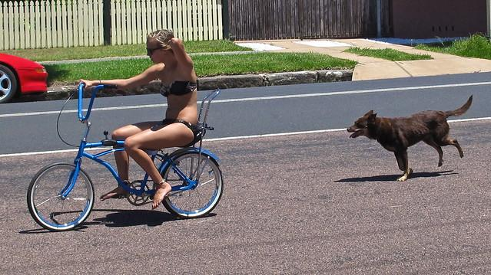
What we will do today (I)
Explore Pre-trained Object Detectors
Input Image
PERSON
CAR
BIKE
DOG
Object Detector

Slide 4

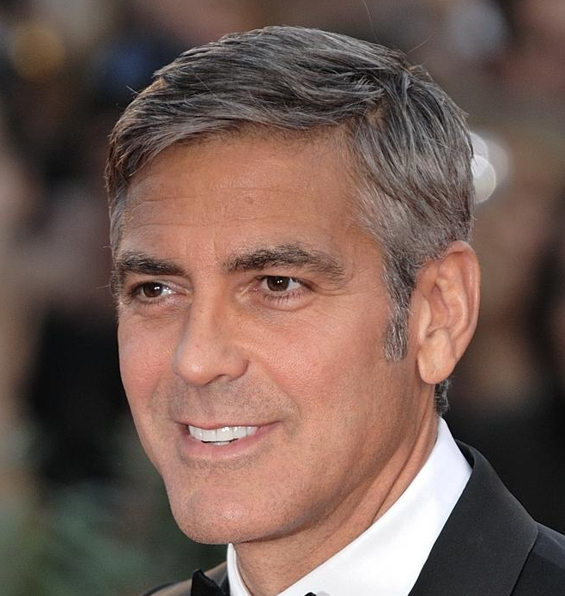
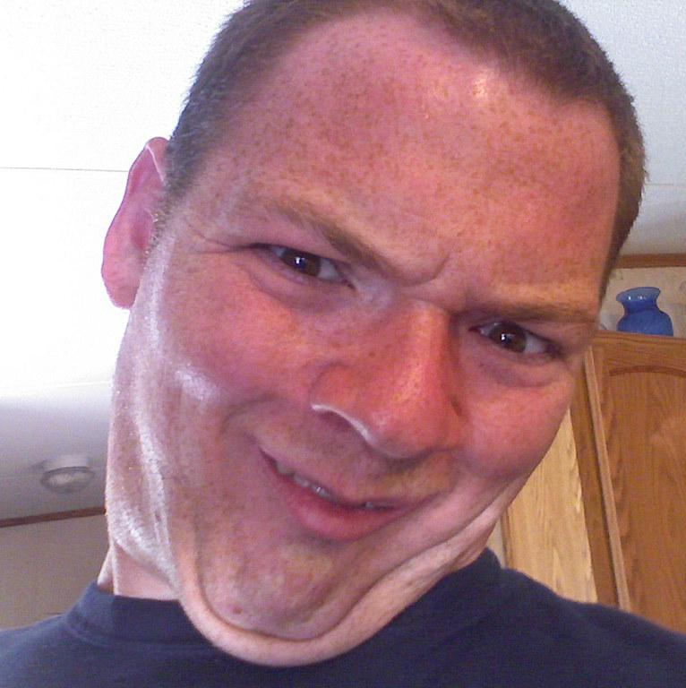
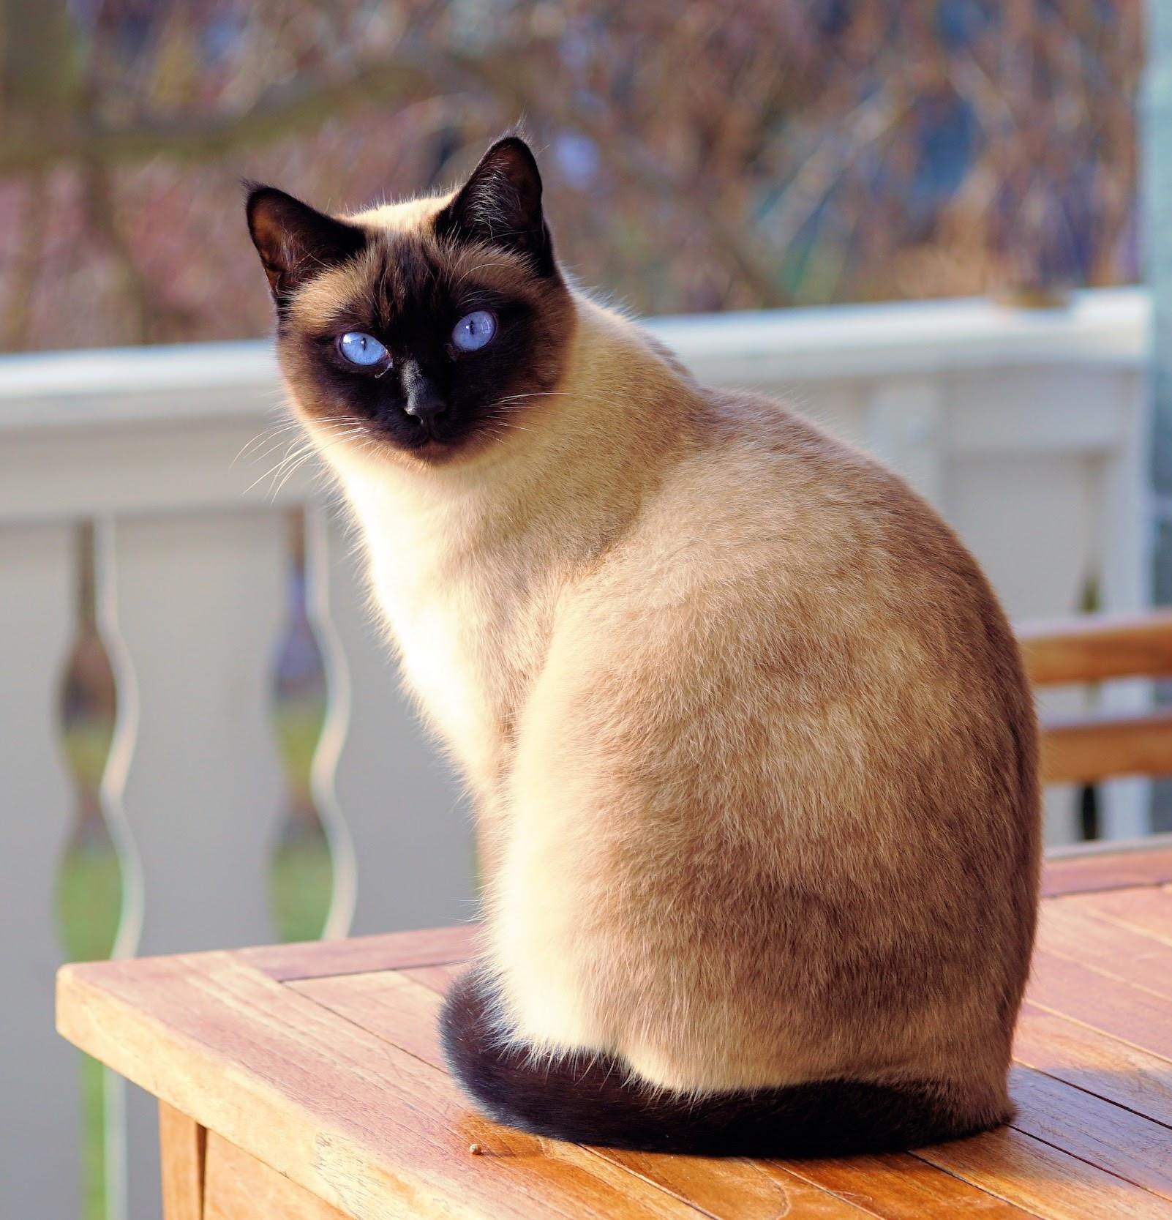
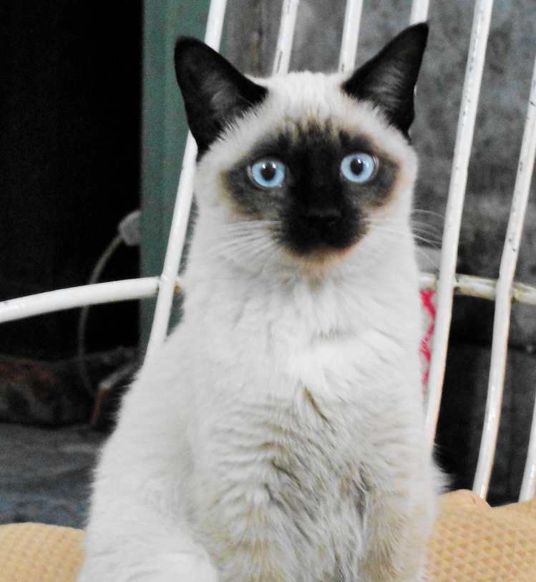
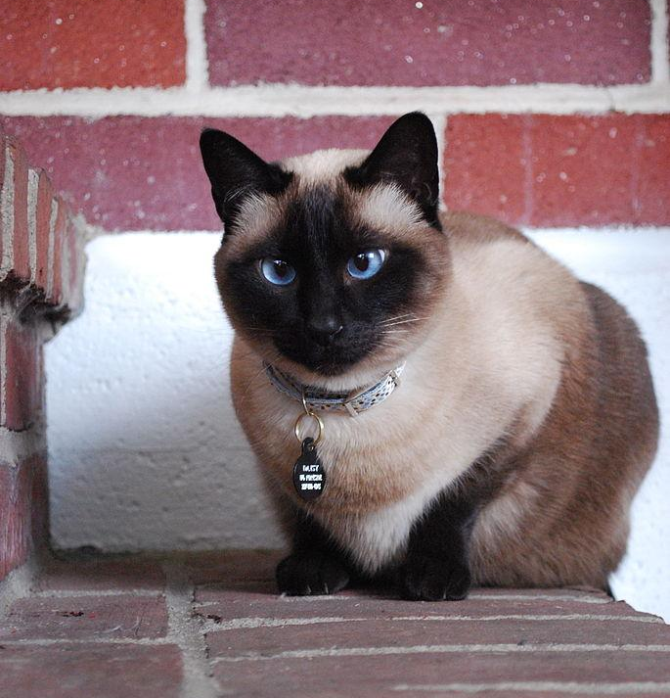
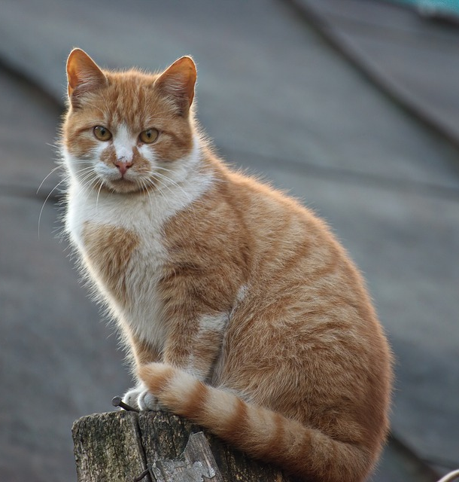
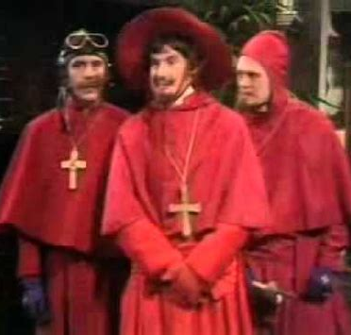
What we will do today (II)
Demo: Celebrity Look Alike
Obj. Detection + Image Verification (Range Queries)
App
You Look Like Clooney!
Query
Results
Discarded
...
Score > 0.9
0.98
0.95
0.83
0.05

Slide 5
Libraries & Technologies
numpy (multi-dimensional arrays)
matplotlib (plotting)
TensorFlow / Keras (deep neural networks)
Services we will use (you will need a Google Account):
Google Colab (for a pre-installed environment and speed via GPUs)
Kaggle (as a source of datasets easily importable into Colab)
TensorFlow Hub (collection of ready-to-use pretrained model for TF)

Slide 6
To Colab

